Slide 1
About
Success
2023.Sep.22
Bolim

Slide 2

My Criteria
Achieve their goals
Personal Interest X
Public Interest O
Notes:
3 criteria
1) Achieve their goal
trivial goalX
the goal of their life
When I first faced this topic on Tuesday, I also thought wealth and honor etc.
But I think It's just our goal that we wanna achieve.
Just setting our goal and achieving it is the Success.
2) The goal is supposed to be for a public interest. Not for the Personal Interest.
If you want someone tell you're a successful person, it is needed.

Slide 3
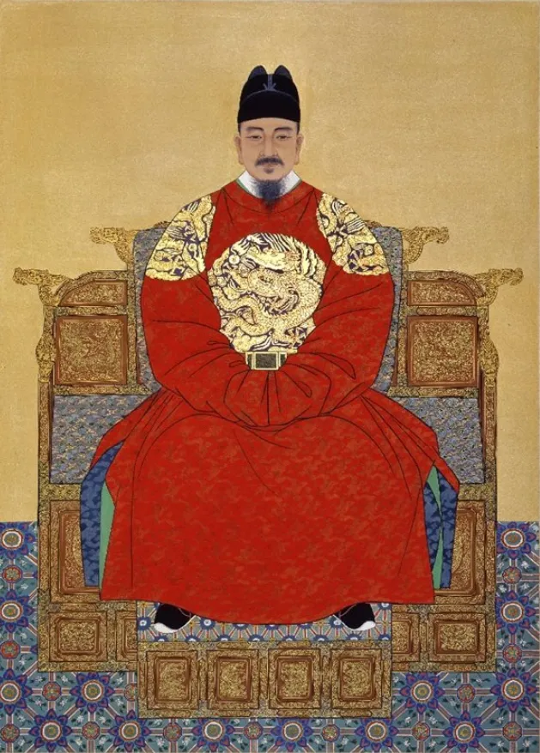
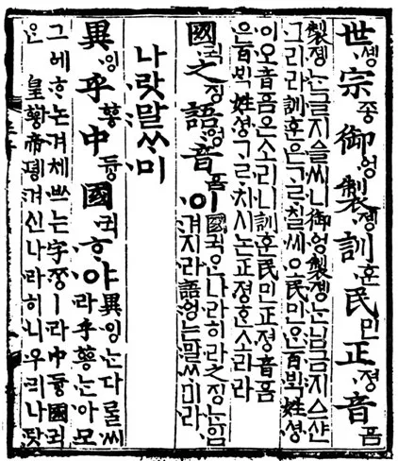
King Sejong
GOAL : Happy life of the people
Achievements : Create ‘Hun-Min-Jeong-Eum‘(Hangul)
make it easy for everyone to learn & feel comfortable.
=> express their thoughts & unfair things
Notes:
HunMinJeongEum means the sound of teaching the people

